Slide 1

From Data to Decisions
Supporting Business Processes with Data Science
Ahmad Marwan Almaghaireh | HTU | Spring 2024-2025
23110205

Slide 2
Project Objective
Leverage data science tools to support decision-making
Focus on marketing insights for 3 Apple iPads
Forecast and visualize trends to aid strategic planning

Slide 3

Products
Selected Products and Company
For this project, I selected three consumer electronics products from Apple Inc., specifically from their tablet category. The chosen products are:
iPad 10th Generation (2022)
iPad Air 5th Generation (2022)
iPad Pro 6th Generation (2022)
These products represent different price tiers and feature sets within the same product line, making them suitable for comparative analysis.

Slide 4

Data Source
The data was collected from Amazon.com using the Helium 10 – Xray Tool, which is a Chrome browser extension that provides real-time analytics for products listed on Amazon. It is widely used in e-commerce analytics for sales estimation, pricing trends, and product tracking
Includes: Time, Sales Rank, List Price, New Price

Slide 5

Dataset Description
Each exported CSV file includes the following columns:
Time: The date of the data record (e.g., daily or weekly timestamp)
Sales Rank: The product's position in Amazon's sales rankings for its category
List Price: The manufacturer’s suggested retail price
New Price: The current selling price offered by vendors on Amazon

Slide 6
Why This Data is Relevant
Sales Rank helps us understand how popular the product is relative to others in the same category.
List Price vs. New Price lets us calculate discount amounts and percentages — critical for evaluating pricing strategy.
Time-based data enables trend analysis and future forecasting using time series models.
These insights are valuable for marketing and pricing decisions, helping stakeholders determine optimal promotional periods, track product competitiveness, and estimate revenue performance.
By focusing on products from the same brand and category but different tiers, we can extract meaningful insights about customer behavior, seasonal trends, and price sensitivity — all of which are crucial for data-driven decision-making in a competitive e-commerce environment.

Slide 7
Data Science Tools and Technologies Used
• Helium 10 – Product data scraping
• Excel – Preprocessing
• Orange – Forecasting (ARIMA)
• Power BI – Dashboard & DAX insights

Slide 8
Helium 10 (Xray Tool) – Data Collection
Purpose: Helium 10 is a product intelligence platform designed for Amazon sellers and analysts. I used the Xray tool within the Helium 10 Chrome extension to extract historical performance data directly from Amazon product pages.
Functionality Used:
Collected data over time for Sales Rank, List Price, and New Price
Exported CSV files for each iPad product
Value: It automates the data collection process and ensures the data is real, accurate, and based on live market activity.

Slide 9
Microsoft Excel – Data Preparation & Enhancement
Purpose: After downloading the raw CSV files, I used Excel to clean the data, unify formats, and add calculated fields.
Actions Taken:
Added new columns:
Year = YEAR([Time])
Month = FORMAT([Time], "MMMM")
Discount Amount = [List Price] – [New Price]
Discount % = ([List Price] – [New Price]) / [List Price]
Combined all datasets into one Excel workbook with six sheets (3 original, 3 forecasted)
Value: Excel allowed for fast manipulation and served as a bridge between raw CSV data and the analytics tools.

Slide 10
Orange – Forecasting and Time Series Modeling
Purpose: I used Orange, a no-code data science tool, to apply time series forecasting using the ARIMA model.
Steps Taken:
Imported CSV files into Orange
Converted the “Time” column to a time series format
Applied the ARIMA model to forecast future product performance
Exported forecast results back into CSV format
Value: Orange simplified the forecasting process without needing programming skills and provided reliable projections of future sales ranks and price trends.

Slide 11
Power BI – Data Analysis, Dashboards, and Visualization
Purpose: Power BI was used to import the processed Excel workbook and build interactive dashboards for each product.
Features Used:
Custom visuals: Line charts (forecast trends), bar charts (discount impact), cards (KPIs)
DAX formulas for calculations like average discount, rank changes, and profit estimates
Page-level dashboards for each iPad model
Value: Power BI transformed the cleaned and forecasted data into actionable insights, helping decision-makers visually compare trends, test pricing strategies, and assess product health in one interface.

Slide 12
How These Tools Support Decision-Making
By combining these tools:
I started with real-time e-commerce data (Helium 10),
Cleaned and prepared it in Excel,
Applied predictive forecasting using Orange,
And created insight-rich dashboards in Power BI.
This full pipeline converts raw data into business intelligence that supports:
Marketing campaign timing
Discount effectiveness assessment
Inventory planning
Long-term pricing strategies
These insights enable more confident and data-driven decisions for both tactical and strategic levels of business management.

Slide 13
Business Process Supported by the Data Science Solution
Targeted Business Process: Marketing and Sales Optimization
The data science solution developed in this project directly supports the marketing decision-making process within an e-commerce business. Specifically, it enables data-driven planning for pricing, promotions, product visibility, and customer engagement strategies.
The primary business process being improved is:
Strategic and tactical marketing planning using historical and forecasted product data
This includes identifying when to promote products, how much discount to apply, and which product lineups need more visibility or investment — all based on real data trends.

Slide 14
How the Solution Adds Value to the Marketing Department
By using sales rank data, price history, and forecasted trends, the marketing team can make informed decisions rather than relying on assumptions or trial and error. The key benefits include:
Optimal Discount Planning: The dashboards clearly show when discounts lead to improved product performance (i.e., sales rank boosts). This helps marketers choose when and how much to discount.
Seasonal Campaign Timing: With time-series data and forecasts, the team can identify high-demand months (e.g., Q2 spikes for certain models) and plan promotions accordingly.
Product Segmentation: Comparing three iPad models helps marketers understand which product is more price-sensitive, allowing them to tailor campaigns to different customer segments.
Better Budget Allocation: Instead of equally distributing marketing spend, decision-makers can prioritize products with higher forecasted performance or those needing support.

Slide 15
Value to the Company as a Whole
Beyond marketing, the solution adds value across other departments and at the executive level:
Sales Team: Insights into discount effectiveness help plan realistic sales targets and promotional goals.
Inventory and Operations: Forecasts help anticipate demand, reducing the risk of overstocking or understocking.
Executives and Strategy: Clear visuals and comparisons make it easier for executives to identify which products are performing best and which need strategic adjustment or investment.
Cross-Department Coordination: With Power BI dashboards accessible to different teams, everyone works from the same data — improving alignment between marketing, sales, and logistics.

Slide 16
Stakeholder Value Assessment
The collected data — consisting of sales rank, list price, new price, and forecasted trends — provides significant value across various business roles. By transforming this raw data into actionable insights using Excel, Orange, and Power BI, the solution supports stakeholders at all levels of decision-making.

Slide 17
Brand Managers – Product Positioning & Trend Monitoring
How they benefit:
Trend Visibility: Brand managers can track how each product performs over time (e.g., if iPad Air gains popularity in Q2 or Q4).
Product Comparison: They can compare performance across different models to evaluate which product needs more support or repositioning.
Discount Sensitivity Analysis: Helps determine if customers respond well to discounts for a specific model, guiding pricing strategies.
Example:
If iPad 10th Gen shows a sharp increase in rank after a price drop, the brand manager may recommend aggressive discounting during back-to-school season.

Slide 18
Sales Managers – Promotional Planning & Target Setting
How they benefit:
Discount Planning: Sales managers can identify how pricing affects sales rank, which directly impacts volume.
Setting Realistic Targets: Forecasting helps in predicting upcoming trends, allowing more accurate sales target planning.
Performance Review: Helps evaluate past campaigns and identify which products met sales goals based on price and timing.
Example:
A sales manager may push promotions for iPad Pro in Q1 if the forecast shows flat performance and competitors are gaining momentum.

Slide 19
Company Executives – Strategic Investment and Portfolio Decisions
How they benefit:
High-Level Insights: Executives get a bird’s-eye view of which products are profitable, stable, or declining.
Informed Investment Decisions: Data shows where to allocate marketing or product development budgets.
KPI Monitoring: Executives can monitor overall brand health, margin trends, and sales response to pricing strategies.
Example:
If iPad Air shows consistent response to moderate discounts and strong seasonality, executives may decide to prioritize this model for international expansion or bundle promotions.

Slide 20
Evaluation of Stakeholder Impact
Stakeholder | Data Used | Impact Gained
Brand Managers | Sales Rank Trends, Discount % | Improve product branding, pricing strategy
Sales Managers | Monthly Rank & Discount Effects | Optimize campaign timing, set realistic targets
Executives | Combined KPIs, Forecast Comparisons | Make strategic decisions on product focus & investment
Notes:
The data and insights generated in this project are not limited to a single team — they serve the broader organization by enabling each stakeholder to make data-backed decisions. By delivering product-specific trends and clear dashboards, the solution ensures alignment between marketing, sales, and corporate strategy.

Slide 21
Design of the Data Science Solution
Flowchart: End-to-End Data Science Pipeline
Notes:
o support decision-making in the marketing and product strategy processes, I designed a full data science pipeline that takes raw e-commerce data and transforms it into interactive visual insights. This pipeline involves four main stages:
START The process begins with a clear objective: to use data to understand product performance and improve marketing strategies.
Collect Amazon Data using Helium 10 Product sales and pricing data is extracted from Amazon using the Helium 10 Xray tool.
Save the Data in Excel The collected CSV files are organized and saved in Excel for further cleaning and formatting.
Clean Data in Excel Unnecessary columns are removed, and new calculated fields such as Discount Amount and Discount Percentage are added.
Import Excel Data into Orange The cleaned data is loaded into Orange, a data science tool used for modeling and forecasting.
Data Analysis & Forecasting Time series forecasting is applied using the ARIMA model to predict future product performance.
Generate Insights and Forecast The forecasts and patterns identified in Orange are exported for further visualization.
Import Data in Power BI Both original and forecasted data are imported into Power BI for dashboard creation.
Create New Columns in Power BI Using DAX formulas, additional metrics are created (e.g., Average Sales Rank, Monthly Trends).
Visualize Patterns Line charts, bar graphs, and KPIs are used to display trends, discounts, and forecasted sales rank.
Analyze Sales by Time Sales performance is analyzed over time to identify seasonal spikes, drops, and patterns.
Identify Best Product Selling A comparison of multiple iPad models helps determine which performs best under different conditions.
Generate Real-Time Insights for Decision-Making The dashboard enables stakeholders to make fast, data-backed decisions on pricing and promotions.
Problem Solved The company gains clear visibility into product performance and can optimize marketing strategy accordingly.
END The process concludes with the delivery of actionable insights that support real business outcomes.

Slide 22
Component Breakdown
Helium 10 (Xray Tool) – Data Collection
What it does: Scrapes historical product performance data from Amazon
Data collected: Sales Rank, List Price, New Price, and Timestamp
Why it matters: Provides real-world, time-based product data from an active online marketplace
Excel – Data Cleaning & Feature Engineering
Why it matters: Transforms messy data into a clean,
enriched dataset with meaningful indicators for forecasting and visual analysis
What it does: Structures the raw CSV files for analysis and adds calculated insights
New fields added:
Year and Month from timestamp
Discount Amount = List Price – New Price
Discount % = (List Price – New Price) / List Price

Slide 23

Orange – Forecasting with ARIMA
What it does: Converts time-series product data into future forecasts
Steps:
Import cleaned CSVs
Use “Form Time Series” to structure time data
Apply the ARIMA model for 12-month predictions
Export results into CSV format
Why it matters: Helps predict how sales rank or prices may behave in future months, aiding in campaign planning and discount strategy
Power BI – Visualization & Dashboard Reporting
What it does: Visualizes the processed and forecasted data using charts, cards, and slicers
Features used:
Line charts for forecast trends
Bar charts for discount analysis
KPI cards (e.g., average discount %, forecasted sales rank)
DAX formulas for dynamic metrics
Why it matters: Converts numeric data into insights that stakeholders (marketers, sales managers, executives) can act on confidently

Slide 24
How the Pipeline Solves the Problem
Stage | Contribution to the Problem
Helium 10 | Collects reliable and up-to-date product data from Amazon
Excel | Cleans data and creates custom metrics needed for analysis
Orange (ARIMA) | Predicts future product trends, allowing proactive decision-making
Power BI | Delivers the results in a user-friendly, visual format for all roles
Notes:
This data science solution is designed to take real-world data and convert it into forecasted insights and actionable visualizations. It supports short-term and long-term decisions for marketing and product strategy by ensuring stakeholders have access to reliable, timely, and clear data.

Slide 25
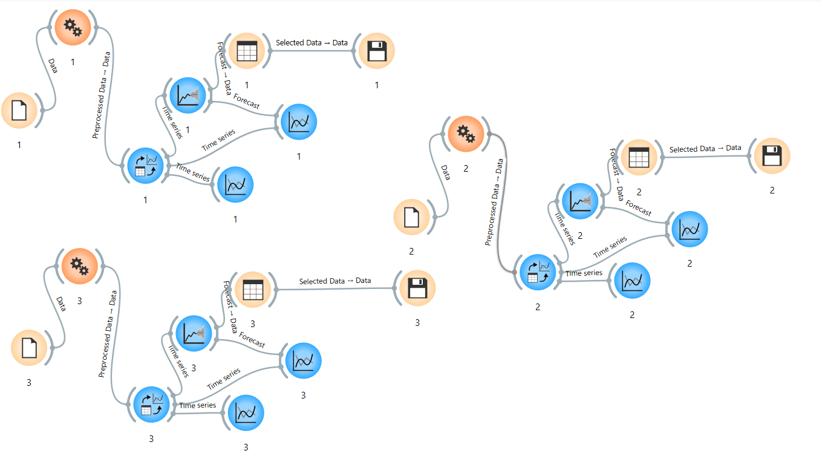
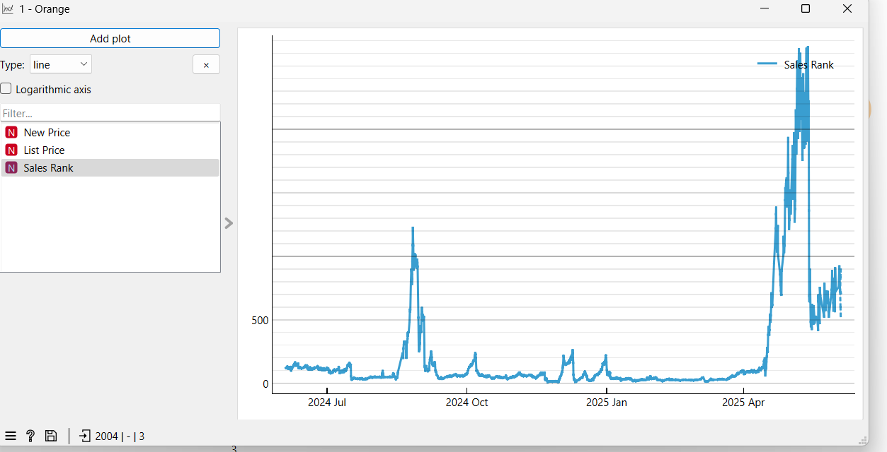
Orange

Slide 26
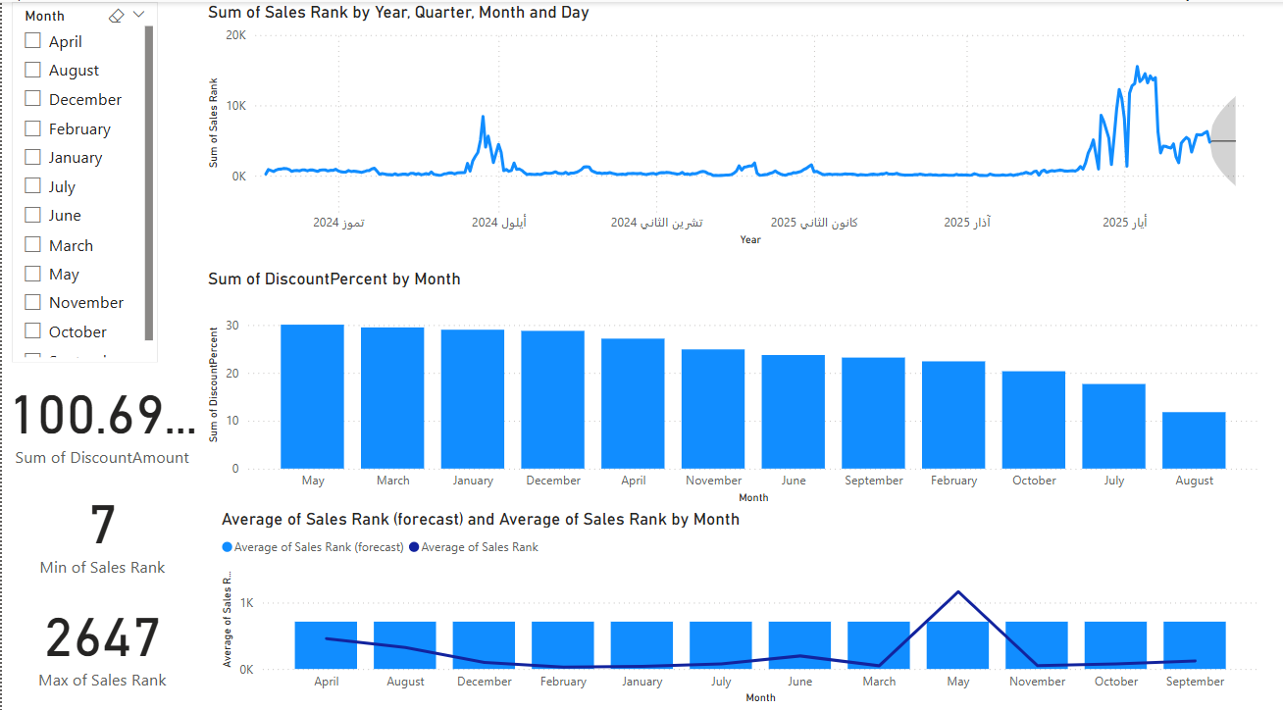
Power BI Dashboard: iPad 10th Gen
Notes:
• Trend of Sales Rank
• Discount impact by month
• Forecasted performance visualized

Slide 27
Analysis of iPad 10th Gen (2022) Dashboard
Metric | Insight
Sales Rank (Line) | Recovery in 2025 after a performance dip in late 2024
Discount Strategy (Bars) | Aggressive early-year discounting (~30%), tapered off later
Forecast vs. Actual | Forecast predicts stable rank, actual values suggest a need for May-focused strategy
Discount Efficiency | Rank improved as discounts decreased → possible brand recovery or demand growth
Strategic Timing Opportunity | Promotions may need re-alignment in Q2 (especially March–May)
Notes:
1. Line Chart: Sum of Sales Rank over Time
Observation: There is a noticeable spike in Sales Rank during mid-to-late 2024, followed by a drop and a more stable trend in early 2025.
Interpretation: A higher Sales Rank value means worse performance (rank = position). So, the spike indicates a temporary decline in sales, while the recovery and flattening in 2025 shows improvement and stability.
Insight: This product might have suffered due to market saturation or low promotion, but recovered possibly due to discounts or seasonal demand.
2. Bar Chart: Sum of DiscountPercent by Month
Observation: Discounts remained consistently high (~30%) from January to May, and then declined gradually through the rest of the year.
Insight: The marketing team used heavier discounts earlier in the year, likely to boost demand post-holiday season or clear stock. As performance improved, discounting was reduced strategically, suggesting controlled pricing and regained consumer interest.
3. KPI Cards
Sum of DiscountAmount: 100.69 (currency unit not shown) Indicates total monetary reduction across all entries — showing significant price adjustment.
Min Sales Rank: 7 This product ranked extremely well at some point — possibly during a promotion or seasonal spike.
Max Sales Rank: 2647 This was the worst rank observed — showing room for improvement in certain periods (e.g., post-launch slump or off-season).
4. Combined Line & Bar Chart: Average Sales Rank vs. Forecast
Observation:
The forecast line (dark blue) shows a stable-to-slightly-decreasing trend — meaning the product’s sales performance is expected to improve.
The actual average sales rank fluctuated more but mirrors the forecast trend.
March and May show spikes in the actual rank (worsening), while forecasted performance stays stable.
Insight: Forecasting suggests the iPad 10th Gen will continue to perform steadily if the discounting pattern remains aligned. The spike in March–May could indicate a need for stronger marketing or better timing of promotions.

Slide 28
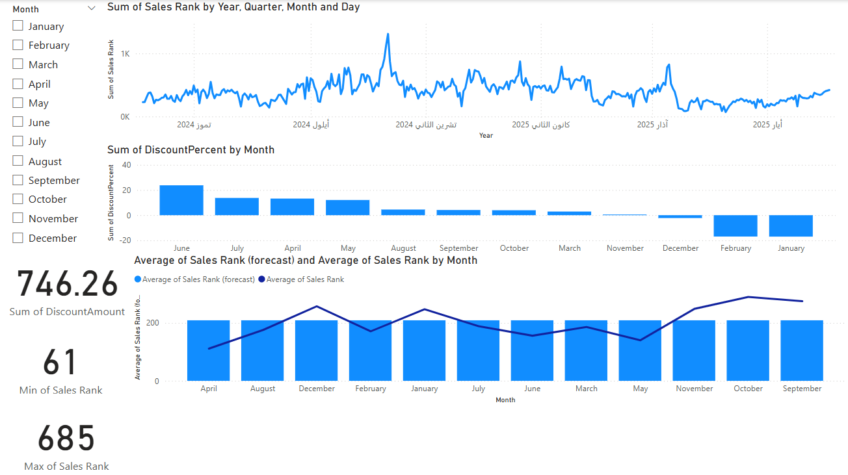
Power BI Dashboard: iPad Air
Notes:
Discount-sensitive product
• Forecast shows high seasonal variance
• Visual KPIs: Sales Rank, Discount %

Slide 29
Dashboard Analysis – iPad Air 5th Gen (2022)
Area | Insight
Sales Rank Trend | Highly variable performance; sensitive to market conditions
Discount Strategy | Q2 had highest discounts → associated with best rank performance
Forecasted Rank | Predicted to increase (worsen) if no adjustments are made
KPI Analysis | Strong potential (Min Rank = 61), but underutilized in later months
Opportunity Window | Consider discounts or ad campaigns in Q1–Q2 to stabilize rank trend
Notes:
1. Line Chart: Sum of Sales Rank Over Time (Top Chart)
Observation:
The Sales Rank fluctuates heavily through 2024, with frequent spikes and drops, especially mid-year.
A notable peak (high rank = low performance) appears in mid to late 2024, with partial stabilization into 2025.
Interpretation:
This product experienced volatile performance, likely due to inconsistent marketing, supply chain issues, or variable competition.
The trend shows high sensitivity to external factors, such as price or timing.
2. Bar Chart: Sum of Discount Percent by Month
Observation:
The most substantial discounts occurred in June, followed by April, May, and July.
From August onward, discounting becomes minimal or nonexistent.
Insight:
Discounts were concentrated in Q2, possibly to drive mid-year sales or clear stock.
After Q2, the lack of discounting may have contributed to loss of rank consistency, especially during late 2024 and early 2025.
3. KPI Cards
Sum of DiscountAmount: 746.26 – This product saw substantial price reductions over time.
Min Sales Rank: 61 – At its best, the product was among the top 100 in its category.
Max Sales Rank: 685 – Even at its worst, the rank was moderate, not extremely poor.
Insight:
The iPad Air generally remained within a competitive zone but showed strong reaction to discounting.
Low ranks occurred when discounts were more aggressive.
4. Combined Line & Bar Chart: Forecast vs. Actual Rank
Observation:
Average actual Sales Rank is variable and peaks around December and January.
Forecasted Sales Rank shows a gradual increase, suggesting worsening performance in the near future.
Insight:
The model predicts that without intervention (like renewed discounts or promotions), sales rank may deteriorate.
The sales rank dips in April and February (historical), which could be good months for campaigns.

Slide 30
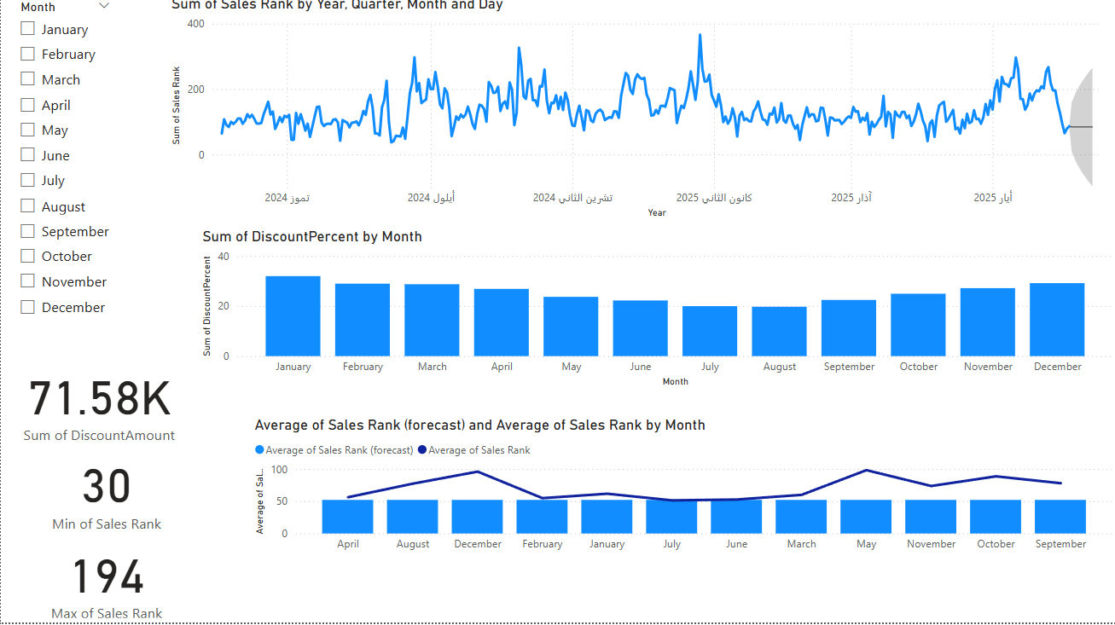
Power BI Dashboard: iPad Pro
Notes:
• Highest priced product
• Steady rank trend
• Slight response to discounting

Slide 31
Dashboard Analysis – iPad Pro 6th Gen (2022)
Area | Insight
Sales Rank Performance | Strong and consistent throughout 2024–2025, with minor competitive dips
Discount Pattern | Focused in Q1 and Q4, aligns with seasonal promotions (holidays, school)
Forecast Trend | Predicts small decline; nothing critical but calls for light promotions
KPI Summary | Very strong overall — lowest Min Rank (30), highest discount value (71.58K)
Strategic Advice | Maintain product strength with minimal discounts and exclusive campaigning
Notes:
1. Line Chart: Sum of Sales Rank Over Time (Top Chart)
Observation:
The Sales Rank fluctuates moderately throughout 2024, with short bursts of lower performance (higher rank).
A spike is seen in early 2025 (performance dip), followed by a sharp drop in rank (improvement) mid-2025.
Interpretation:
The iPad Pro is relatively stable, showing less volatility than iPad Air but more than iPad 10.
Spikes may correlate with release cycles of competitors or end-of-quarter drops in promotion.
Insight:
The iPad Pro generally maintains a strong rank (better performance) and seems less price-sensitive.
2. Bar Chart: Sum of DiscountPercent by Month
Observation:
Discounting is spread across the year, with noticeable reductions in Q1 and Q4, especially in January, February, and December.
Q3 and early Q4 (e.g., August–October) show lower discount rates.
Insight:
Discounts are likely strategic and seasonal (e.g., back-to-school, holiday offers).
Despite moderate discounts, performance remains strong → indicates a loyal, premium-seeking audience.
3. KPI Cards
Sum of DiscountAmount: 71.58K – Significantly higher than the other two products.
Min Sales Rank: 30 – At its best, it's among the top 50 ranked tablets.
Max Sales Rank: 194 – Still within a strong performance range, unlike iPad 10 which peaked at 2647.
Insight:
Even with minimal or moderate discounts, iPad Pro remains high-ranking → implies brand strength and low price sensitivity.
4. Combined Line & Bar Chart: Forecast vs. Average Sales Rank
Observation:
Forecasted Rank (dark blue line) predicts a slight increase in rank (worsening) in the near future.
The actual rank remains tightly clustered between 40 and 100, showing high consistency.
Highest forecasted value occurs in December, which matches a known high-discount season.
Insight:
Forecast suggests a mild decline, possibly due to seasonal competition or new product launches.
Historical resilience indicates the iPad Pro can maintain its position with even slight promotions or strategic positioning.

Slide 32
iPad Pro 6th Gen is the Best-Selling Product
Product | Min Sales Rank | Max Sales Rank | Stability | Forecast Trend | Discount Dependency
iPad 10th Gen | 7 | 2647 | Medium | Improving slightly | Sensitive to early-year discounts
iPad Air | 61 | 685 | Low | Worsening (unstable) | Highly sensitive to discounting
✅ iPad Pro | 30 | 194 | High | Slight decline | Performs well even with light discounts
Notes:
It consistently maintains a strong sales rank between 30 and 194, meaning it stays near the top of its category.
It performs well without heavy discounting, indicating strong brand loyalty and value.
Forecasts show only a mild decline, and historical data suggests that even minor promotional support can stabilize performance.

Slide 33
Recommendations
iPad 10th Gen (2022) – Entry-Level Product
Maintain moderate discounting during Q1 and Q2 → Sales rank improved after early-year discounts (~30%), and forecast shows steady recovery. Continuing this strategy can sustain growth.
Target March–May with stronger promotions → Sales rank spiked (worsened) during this period historically. Adding targeted ad campaigns or bundle deals could stabilize performance.
Use this product for high-volume promotional campaigns → Despite its low-price tier, the product once reached Rank 7. It responds well to visibility and pricing pressure.

Slide 34
Recommendations
iPad Air 5th Gen (2022) – Mid-Tier Product
Reintroduce discounts in Q2 and Q3 → Product performed best during high-discount months (April–July). Forecast shows decline without intervention — discounting can reverse this.
Monitor performance monthly → This product showed high volatility. Continuous tracking will help quickly respond to sudden rank drops.
Bundle with accessories or offer time-limited flash sales → As a mid-tier device, it's ideal for bundling strategies to add perceived value while protecting margins.

Slide 35
Recommendations
iPad Pro 6th Gen (2022) – Premium Product
Limit discounts to key periods like Q1 and Q4 only → Product is not very price-sensitive. Performance remains strong even with moderate discounts, especially in January and December.
Maintain brand exclusivity and premium perception → Keep messaging focused on quality and performance, not pricing. Minimal campaigns can still be effective with targeted audiences.
Use small, seasonal promotions to maintain forecasted stability → Forecast suggests a slight decline — nothing major, but light promotions in December or early 2025 can prevent this.

Slide 36
Cross-Product Strategy Recommendations
Apply dynamic pricing and forecasting across all product tiers → Power BI + ARIMA forecasting can help update strategies monthly based on real-time sales rank trends.
Align promotional strategy with product sensitivity → iPad Air needs more aggressive discounting, while iPad Pro requires minimal touchpoints to stay competitive.
Use data storytelling for stakeholder buy-in → Present these insights visually to sales, marketing, and executive teams to support fast and informed decisions.
Notes:
These recommendations are rooted in real-world data trends and forecast predictions. By tailoring marketing strategies to each product’s behavior, the company can improve rank performance, optimize discount spending, and maximize return on promotional investment.

Slide 37
Evaluation of the Data Science Solution
Notes:
The data science solution designed for analyzing iPad product performance was built with the goal of supporting strategic marketing decisions through real-world Amazon data, forecasting techniques, and visual insights. In this section, I evaluate the solution’s effectiveness against business goals, identify any limitations, and propose future improvements.

Slide 38
Evaluation Against Business Requirements
Business Requirement | Evaluation Result
Use real-world data from a trusted source | ✅ Data was collected from Amazon via Helium 10, ensuring reliability and relevance
Provide insights for pricing and promotions | ✅ Dashboards clearly link discount patterns to performance outcomes
Forecast future trends for marketing planning | ✅ Orange’s ARIMA models provided time series forecasts for each product
Support multiple stakeholders | ✅ Visuals support brand managers, sales teams, and executives with tailored insights
Enable comparative analysis across product tiers | ✅ Side-by-side dashboards for iPad 10, Air, and Pro allow easy comparison

Slide 39
Evaluation Against User Needs (Marketing Department)
User Need | How It Was Met
Understand which products are price-sensitive | ✅ Power BI visuals + discount impact charts show clear price-performance links
Plan seasonal promotions | ✅ Forecasts indicate when performance may dip, allowing proactive campaign timing
Optimize budget usage | ✅ Discount efficiency and rank trends show when marketing spend has best impact
Communicate results visually to management | ✅ Dashboards use cards, line charts, and slicers to simplify communication

Slide 40
Identified Gaps & Limitations
Gap / Limitation | Impact
No real-time data integration | The solution relies on static CSV exports; no live updates or automation
Only three products were analyzed | Limits generalizability and broader market understanding
Forecasting model assumes linear trends | ARIMA cannot fully account for new product launches or competitor activity
External factors not modeled | Reviews, ads, and stock availability not included
Limited interactivity across dashboards | Each product is on its own page — no single comparative view for executives

Slide 41
Suggested Improvements
Automate Data Collection via API Replace manual CSV exports with API-based data ingestion for live updates and better scalability.
Expand Product Coverage Include more Apple products (e.g., older iPads, iPhones, accessories) to provide a full-market analysis.
Enhance Forecast Accuracy Introduce additional features (e.g., marketing spend, review volume, competitor prices) into the forecasting model.
Interactive Comparative Dashboard Add a “summary dashboard” that visually compares all three products in one view for executive decision-making.
Include ROI Calculation Add measures to calculate return on discount or promotion investment to strengthen strategic planning.
Notes:
The data science solution meets most of the company’s business and user needs by transforming raw product data into strategic insights. While it performs well for a pilot project, enhancing automation, model complexity, and dashboard interactivity would significantly improve its long-term value and scalability.

Slide 42
Social, Legal, and Ethical Implications of Using Data
Legal Implications
1. Data Ownership and Terms of Use
The data was collected from public Amazon product pages using Helium 10, a commercial tool that operates within Amazon’s API limits.
No private customer data or proprietary internal data was accessed.
However, companies must always ensure that third-party data tools (like Helium 10) are compliant with platform terms of service to avoid potential legal violations.
2. Intellectual Property
Product names, images, and other branded elements belong to Apple and Amazon. While only metadata (sales rank, pricing) was used, legal caution must be taken not to misrepresent or misuse brand content.
3. Data Compliance
Since no personal data was involved, regulations like GDPR or CCPA were not triggered. However, any future extensions involving customer feedback or behavior would require compliance with such data protection laws.
Notes:
Using data and information in a real-world business context — especially from e-commerce platforms like Amazon — comes with various social, legal, and ethical responsibilities. In this project, care was taken to use data ethically and in alignment with best practices, but it’s important to assess the broader implications to ensure trust, compliance, and fairness.

Slide 43
Social Implications
1. Consumer Impact
Insights derived from this project could influence marketing decisions, such as when and how aggressively to promote or discount products.
If not handled responsibly, such decisions can lead to price manipulation or mislead consumers (e.g., inflated discount claims).
2. Market Fairness
Data-driven promotions may give larger companies an edge over smaller competitors who cannot afford advanced analytics, potentially widening digital inequality in the e-commerce space.
3. Accessibility
Relying solely on data may overlook non-digital consumer behaviors, potentially excluding demographics with less access to online platforms.

Slide 44
Social, Legal, and Ethical Implications of Using Data
Ethical Implications
1. Transparency
It’s important that the company using these insights is transparent with customers about pricing strategies and does not use data to mislead or manipulate.
2. Data Bias
Although the data was numerical (price, rank), bias can still emerge:
Focusing only on top-selling products may ignore niche markets.
Assuming all customer decisions are driven by price may oversimplify real behavior.
3. Responsible Forecasting
Forecasts must be used to guide, not to guarantee, outcomes. Misusing predicted trends to pressure consumers (e.g., fake scarcity) would be unethical.

Slide 45
Social, Legal, and Ethical Implications of Using Data
Mitigation and Good Practice
To handle these implications responsibly, the following principles should be followed:
Use data tools that respect platform terms and legal boundaries.
Avoid using any personally identifiable information (PII) without consent.
Disclose pricing and promotional strategies clearly to consumers.
Cross-check data with qualitative insights to avoid over-reliance on numbers.
Maintain transparency, fairness, and accountability in all data-driven decisions.
Notes:
While this project used publicly available product data ethically and legally, the broader use of data science in e-commerce must always consider its impact on consumers, fairness in the market, and legal compliance. Ethical use of data is not just a technical responsibility — it’s a commitment to social trust and corporate integrity.

Slide 46
Data Security Threats and Protection Measures
Potential Data Security Threats
1. Unauthorized Access to Forecasted Data
If the forecasted sales trends or pricing insights are accessed by unauthorized parties (e.g., competitors), it may result in strategic disadvantages.
2. Data Corruption or Loss
Improper file handling, lack of backups, or hardware/software failure could result in the loss of original or processed data, damaging the entire project pipeline.
3. Insecure File Sharing
Sharing Excel sheets, forecast CSVs, or Power BI dashboards over email or public cloud platforms without protection can lead to interception or manipulation.
4. Malicious Code in Forecasting Tools
While tools like Orange and Power BI are generally safe, using third-party extensions or scripts might introduce malware or data leaks.
5. Accidental Data Exposure
Visuals shared with the wrong audience or published online (e.g., dashboards with internal strategy notes) can unintentionally reveal business insights.
Notes:
Although the data science solution developed for this project does not involve sensitive or personal data, it still faces security risks related to the handling, storage, and sharing of business-related information. Any compromise in data integrity or access control could lead to financial loss, reputational damage, or loss of stakeholder trust.

Slide 47
Proposed Security Measures
1. Access Control and Role-Based Permissions
Use password-protected folders or cloud storage (e.g., OneDrive, Google Drive) with read/write access limited to authorized users only.
Power BI dashboards should be shared via Power BI Service with role-level security (RLS) to restrict access.
2. Data Encryption
Encrypt Excel workbooks and forecast files before sharing. This ensures that even if the files are intercepted, the content remains unreadable.
Use encrypted cloud storage and secure HTTPS connections for web tools.
3. Regular Data Backups
Keep backups of:
Raw CSV files from Helium 10
Processed Excel files
Orange workspace files (.ows)
Power BI reports (.pbix)
Store backups in multiple secure locations (local and cloud).

Slide 48
Proposed Security Measures
4. Antivirus and Software Updates
Ensure that Orange, Excel, Power BI, and all operating systems are up to date.
Use antivirus protection to scan all files, especially when importing/exporting CSVs.
5. Audit and Logging
If using Power BI Service or a shared cloud space, enable activity logging to track file access, edits, and shares.
6. Training and Awareness
Ensure all team members understand safe data handling, how to avoid phishing scams, and how to manage shared content responsibly.
Maintaining Trust:
Implementing these security measures helps protect:
Data integrity (no tampering)
Confidentiality (only the right people access the right data)
Business trust (confidence in the insights being accurate and safely managed)
This builds long-term confidence in both the system and the team managing it — a critical factor when working with real-world business data.
Notes:
While this project does not use personal or classified information, it still requires strong data protection practices to avoid misuse, ensure accuracy, and maintain organizational credibility. Investing in proper access controls, encryption, and training ensures that insights remain safe and stakeholders remain confident in the system.

Slide 49
Case Study: Data Scraping Breach at Alibaba’s Taobao Platform
Company: Alibaba Group – Taobao.com
Incident Year: 2020
Type of Breach: Unauthorized data scraping and leakage of user data
What Happened
In 2020, Alibaba reported that a developer had used a crawler script to scrape data from Taobao, its massive online marketplace. Although the data was publicly visible to logged-in users, the volume and method of collection made it a serious breach of terms and trust.
The attacker had used automated scripts to collect more than 1.1 billion pieces of user information, including:
Usernames
Purchase histories
Contact information (in some cases)
This data was later resold to third-party advertisers and black-market brokers, violating Alibaba’s user policies.

Slide 50
Impact on Alibaba and Its Customers
User Trust Breach: Users were shocked that their data was quietly collected and sold, despite being visible only to authorized users.
Regulatory Scrutiny: Chinese authorities investigated Alibaba’s internal controls and data protection practices.
Reputational Risk: Even though it wasn’t a classic “hack,” public perception of Alibaba's data handling was damaged.
Legal Action: The developer behind the scraping was arrested, but Alibaba still had to address the internal oversight.

Slide 51
Recovery Actions Taken
Internal Policy Review: Alibaba reviewed its user data access controls, especially those linked to developer APIs and backend scripts.
Rate-Limiting & Bot Detection: They strengthened their anti-scraping tools to detect and block bulk download behaviors.
Transparency Improvements: The company issued public statements about how the data was accessed and how such activity would be prevented in the future.
Developer Access Tightening: Permissions for third-party data access were restricted, and monitoring systems were improved.

Slide 52
Lessons for Our Organization
Lesson | Application to Our Project
Public data can still be exploited | Even if data is not confidential, control access to dashboards and reports
Bots and automation can go unnoticed | Limit and monitor repeated downloads or file access
Internal activity must be logged and reviewed | Log all data access and monitor for unusual patterns
User perception matters as much as legality | Be transparent and clear about how data is used or displayed
Not all threats are external | Developers or internal users must follow strict access protocols
Notes:
The Alibaba case shows that data scraping and misuse of public information can still lead to major damage — not because of the sensitivity of the data, but because of how it is collected and redistributed. For our project, this reinforces the need to:
Set clear rules on who can access Power BI and Excel outputs
Monitor for unusual access patterns
Communicate clearly with stakeholders about how data is used and protected
This proactive approach will help us build a solution that is both secure and trustworthy.

Slide 53
References
Alibaba Taobao Scraping Incident (2020):
Reuters. (2021). Chinese court jails developer for scraping Alibaba’s Taobao user data. Reuters. Available at: https://www.reuters.com/article/us-china-alibaba-court-idUSKBN2BO4OH [Accessed 7 Jun. 2025].
Wang, Q. (2021). Taobao Data Leak: Developer Scraped 1.1 Billion User Records. TechNode. Available at: https://technode.com/2021/04/27/taobao-developer-jailed-over-scraping-1-1-billion-user-records/ [Accessed 7 Jun. 2025].
South China Morning Post (SCMP). (2021). Alibaba customer data leak blamed on web crawler used by developer. SCMP. Available at: https://www.scmp.com/tech/big-tech/article/3131079/alibaba-customer-data-leak-blamed-web-crawler-used-developer [Accessed 7 Jun. 2025].

